Slide 1
Implementation of 2 Antenna Array Static Beam-Steering Front-Ends at 2.4 GHz
Submitted By:
Rahul Khanna
13BEC0700
F1 slot
Submitted To:
Prof. Prabu K.

Slide 2
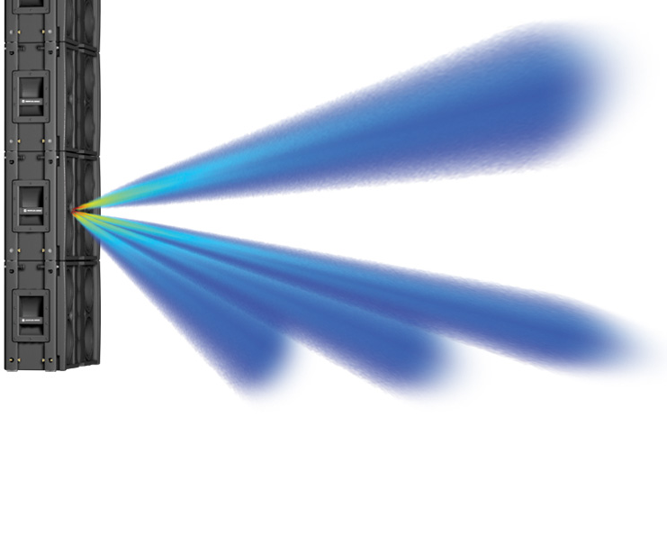

Beam Steering
Beam steering is about changing the direction of the main lobe of a radiation pattern.
In radio systems, beam steering may be accomplished by switching the antenna elements or by changing the relative phases of the RF signals driving the elements.
In optical systems, beam steering may be accomplished by changing the refractive index of the medium through which the beam is transmitted

Slide 3
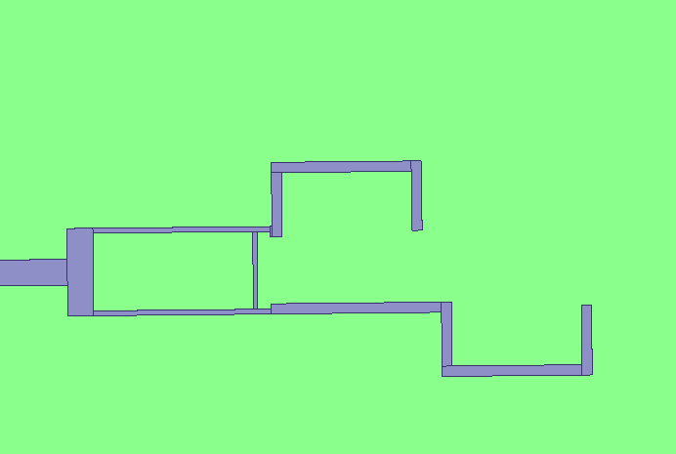
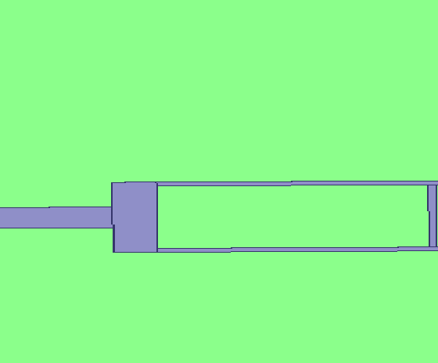
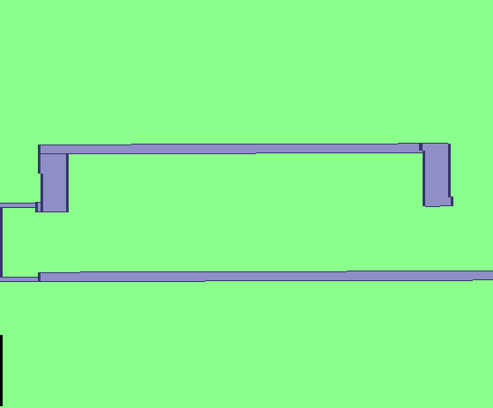

Circuit Design (Basic):
Substrate: Er=3.4
H=0.59mm
T=0.254mm
Tand=0.002
Results
Contribution
Circuits
Comparison
END

Slide 4
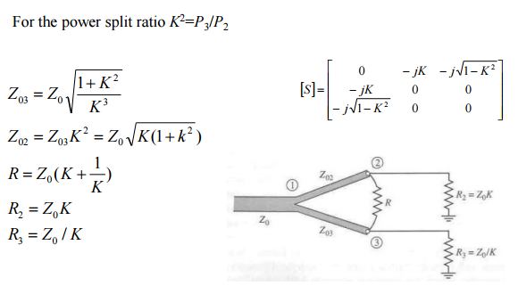
Power Divider
Wilkinson Power Divider:
By introducing a resister in between output port, such that they are matched, the Wilkinson power divider gives best power split with isolation between the output ports.
Back

Slide 5
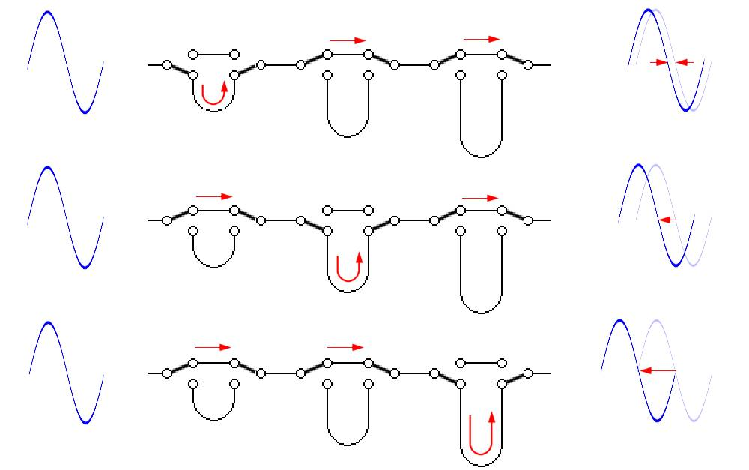
Phase Shifter
Phase shifters are used to change the transmission phase angle (phase of S21) of a network. Ideal phase shifters provide low insertion loss, and equal amplitude (or loss) in all phase states.
In the base paper, branch line coupler with varactor is use to change the phase.
Back

Slide 6
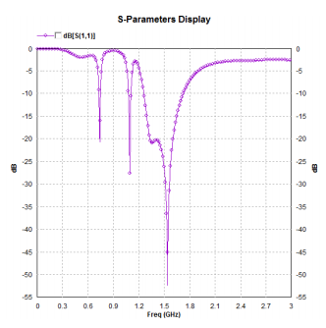
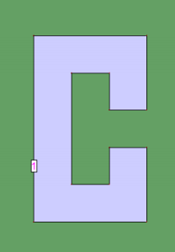
C Antenna
The most suitable types of antenna for beam-steering systems are those with a radiation pattern in a torus shape that are isotropic in the plane Φ = 0, i.e., independent of θ in the aforementioned plane . A C-shaped monopole antenna was proposed by and optimized at 2.4 GHz. Only one of the two antenna branches was kept for our work and dimensions were optimized to maximize matching. Its length is approximately λ/4 and its width had to be changed to 1.86 mm in order to match impedance with PD and phase shifters.
Back

Slide 7
Results:
DB[S(1,1)]
Return Loss
Total Directivity
(DB) [3D]
Total Directivity
(DB) [Radiation Pattern]
Back

Slide 8
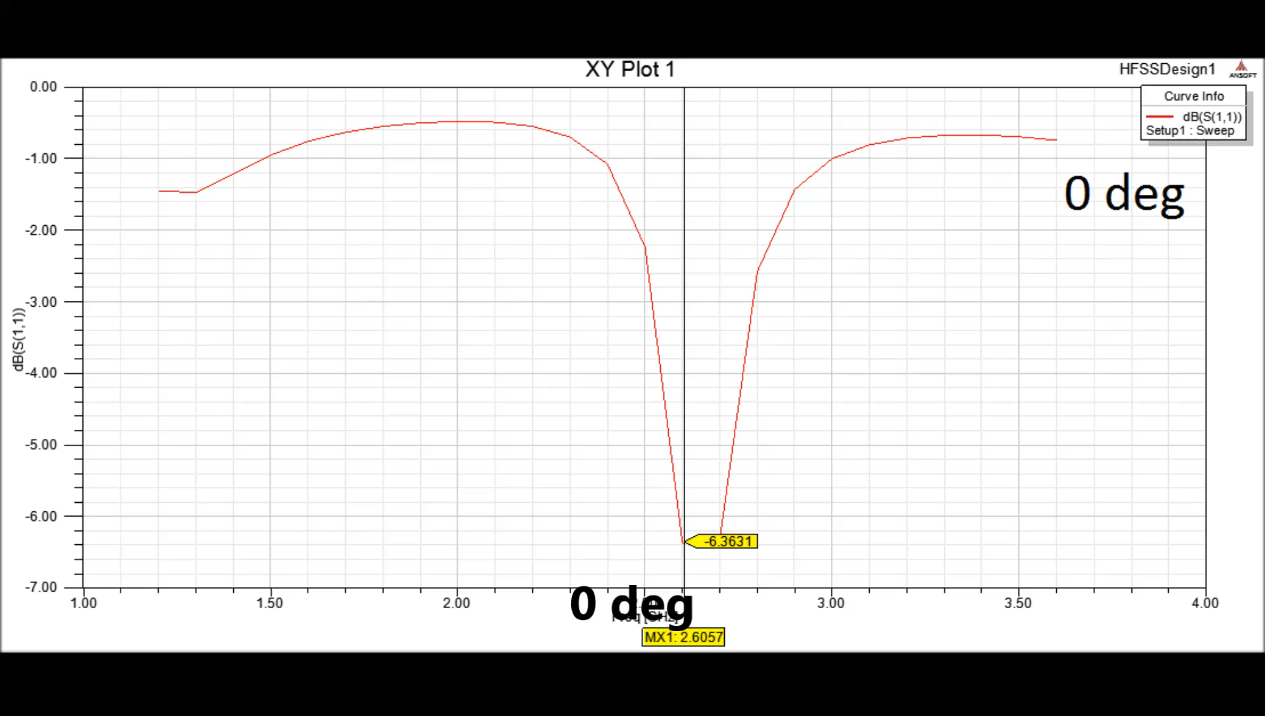
DB[S(1,1)] :Return Loss
Back

Slide 9
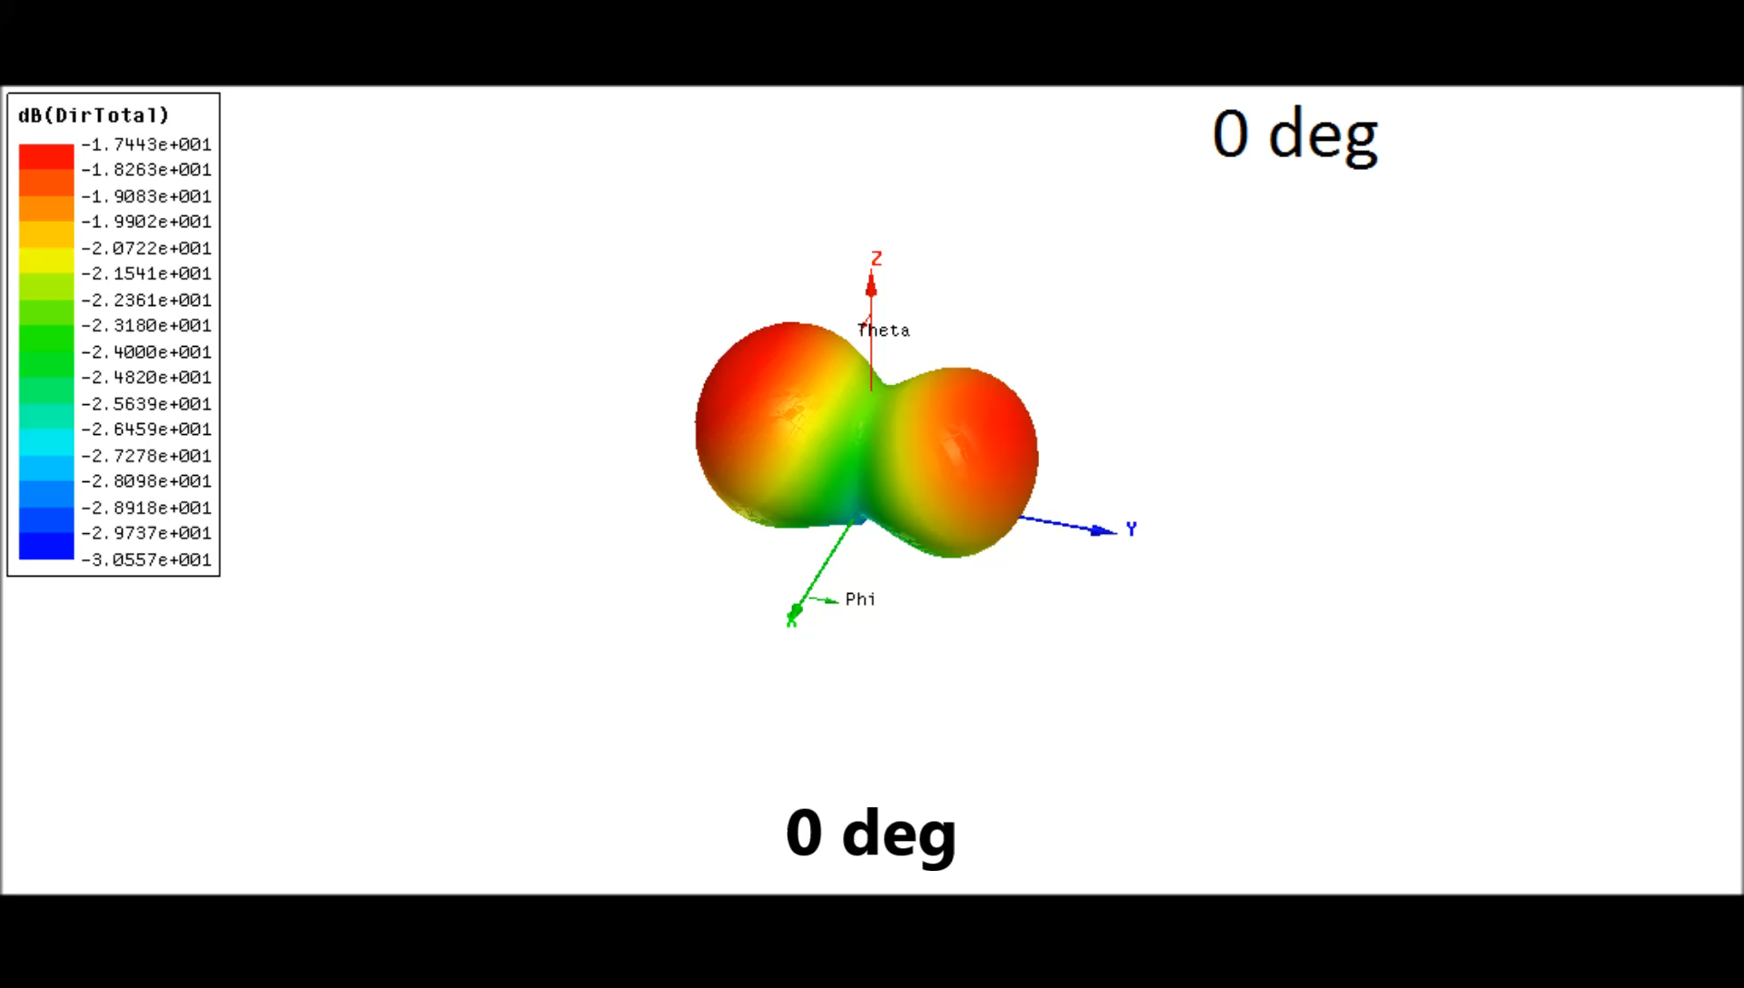
Total Dierectivity: (DB) [3D]
Back

Slide 10
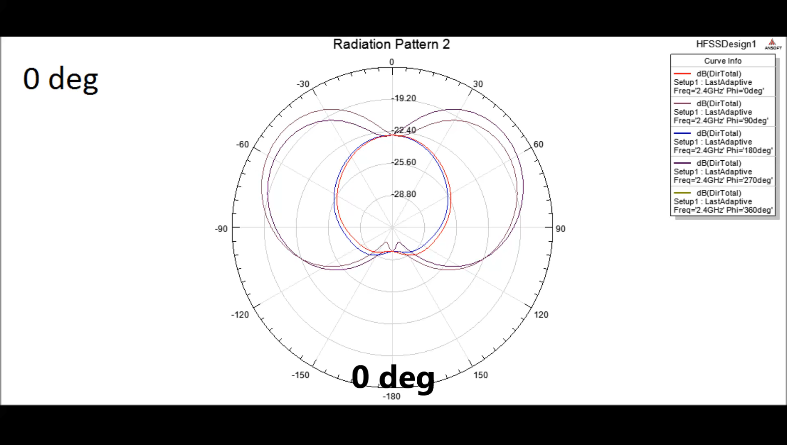
Total Dierectivity: (DB) [Radiation Pattern]
Back

Slide 11
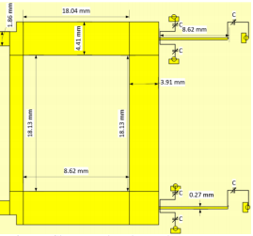
Contribution:
My contribution in the project is that I have replaced the branch line coupler with varactor (phase shifter) with two microstrip lines of varying lengths to obtain the phase shift.
Also, I have obtain the results for 0, 45, 90, 135, 180, 225, 270, 315 deg
Back

Slide 12
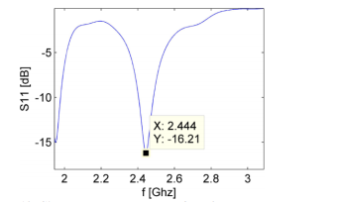
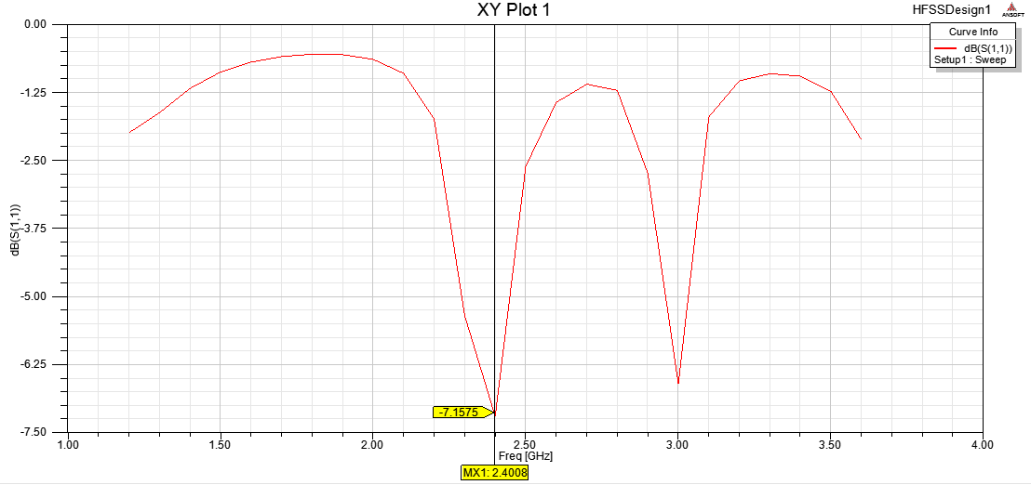
Comparison:
Results obtained in my project are approximately similar to that in base paper.
Back

Slide 13
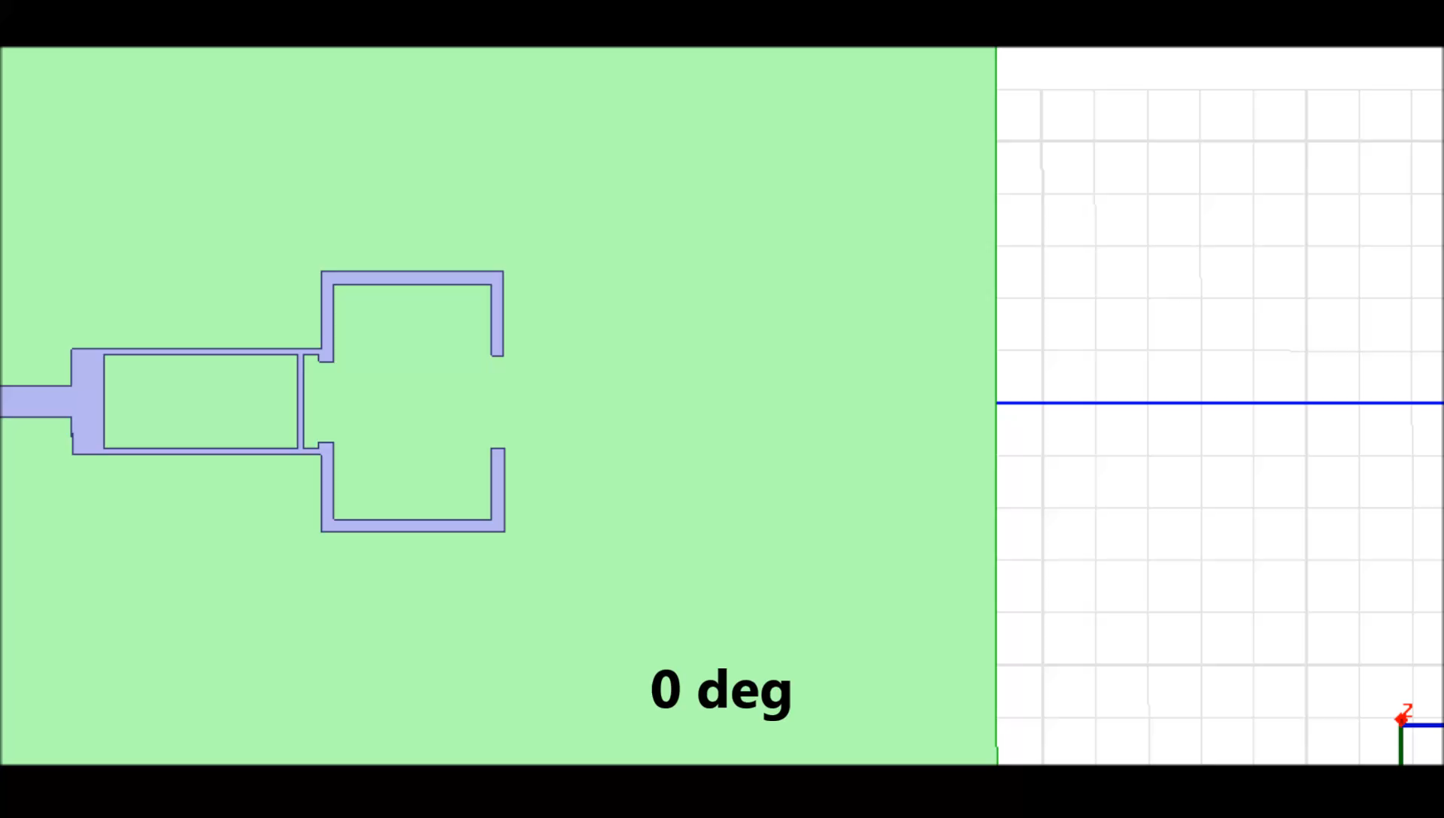
Circuits With Phase Shifts from 0-360 deg
Back

Slide 14
Reference:
Base research paper on “Implementation of Beam-Steering Front-Ends at 2.4 GHz”.
Microwave Engineering David M Pozar 4th edition Wiley-2012
Wikipedia- Beam steering, phase shifters
HFSS : www.ansys.com/Support/platform-support
THANK YOU
Back

